Slide 1
Fundamentals of Knowledge Economy

Slide 2
Internet economy
The Internet economy (also called the .com economy or dot-com economy) refers to business conducted through markets whose infrastructure is based on the Internet and World Wide Web.
An Internet economy differs from a traditional economy in a number of ways, including: communication, market segmentation, distribution costs, and price.
The Internet is making economic activity more efficient, faster, and cheaper, and extending social interaction in unparalleled ways.
The Internet is quickly permeating all economic and social domains, and most public policy areas. For instance, e-government has become the prime tool for supporting government functions and interaction with citizens and businesses.
Healthcare systems are increasingly making use of the Internet and online networks to increase affordability, quality and efficiency, through electronic patient record systems, remote patient monitoring and healthcare delivery, along with improved diagnostics and imaging technologies.
Educational performance is found to be correlated with home access to, and use of, computers. Moreover, environmentally-friendly technologies based on the Internet in buildings and transport systems and alternative power generating systems can help address climate change and improve energy efficiency.

Slide 3
E-business – Conceptual premise and topologies
Electronic Business (E-Business) is the administration of conducting any business using the internet, extranet, web, and intranet. This would include buying and selling of goods or services using commercial transactions conducted electronically along with providing customer or technical support with the help of the internet. E-business is similar to E-commerce but it is more than just a simple act of buying and selling services or goods online. In fact, it is the method of utilizing digital information and advanced communication technologies to streamline different business processes – from the initial to the implementation phase. E-business includes a lot of business processes including online order processing, CRM (Customer Relationship Management), supply chain management, and many more. E-commerce is a part of e-business, so let me give you a comprehensive detail about what is e-business.

Slide 4

E-business has several components including BI (Business Intelligence), CRM (Customer Relationship Management), ERP (Enterprise Resource Planning), SCM (Supply Chain Management), Collaboration, online activities, and electronic transactions within the firm. But following three areas have great importance for e-business

Slide 5
1. E-Procurement
It is also known as supplier exchange in which business to business, business to government, business to consumer, and sales of services are made with the help of the internet. Basically, e-procurement is a way adopted by companies to reduce costs and efforts by sourcing products or services electronically.
2. Online Stores
It is electronic sourcing (website or application) for products or services, such as online shopping stores. Online stores are also known as e-shops, internet shops, web-store, virtual stores, web-shop, m-commerce, and online storefront. The main purpose of these online stores is to save precious time and money.
3. Online Marketplace
It is electronic commerce that connects the buyers and suppliers to the services or products over the internet. Keep in mind, that the operator of an online marketplace only presents the inventory of other people and provides the transaction facility
4. Online Communities
Online communities (also known as web communities or internet communities) are groups of people having the same interests or purposes who use the internet to communicate with each other. It is used between individuals and organizations to prepare transaction decisions.
5. Online Companies
It is electronic business cooperation that connects the individual companies and forms a virtual business with a common transaction offer

Slide 6
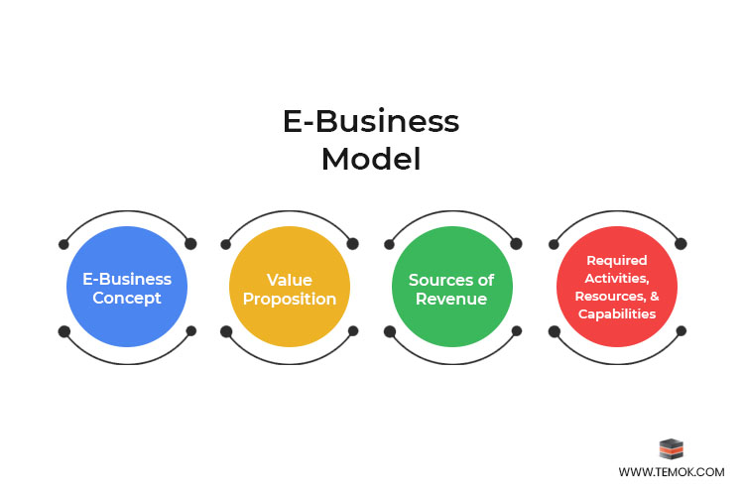
2. Value Proposition
As the name denotes, the value proposition is a value that an organization or business will provide to its customers. It may include one or more of the following points:
Reduced price
Improved service or better functionalities with user-friendliness
Speedy delivery and improved assistance
Products or services that result in greater efficiency and productivity
Access to available inventory has different options for the buyer
1. E-business Concept
What is e-business concept and how is it essential for a successful business? It describes the basic information of the business including goals, vision, products, and offers from which it will earn revenue. The effective concept is based on market analysis that will identify the customers’ interests to purchase the product and how much they can pay for it

Slide 7
3. Sources of Revenue
Advertisement
Affiliation
Agent/Representative commissions
Licensing
Sales commissions
Sponsorship
Syndication
Use Fees
Subscription
2. Value Proposition
Reduced price
Improved service or better functionalities with user-friendliness
Speedy delivery and improved assistance
Products or services that result in greater efficiency and productivity
Access to available inventory has different options for the buyer

Slide 8
NETWORK TOPOLOGIES IN E-COMMERCE
When setting up the computer systems for your e-commerce enterprise, you need to figure out how your computers will be configured in relation to each other. Your computer systems need to communicate with each other in some fashion based on how many people are working together and what kinds of computer files and resources they share. The way they are tied together in your computer network is known as a network topology. There are three primary topologies common to most computer networks, and you can either adopt one of them or combine different elements of each.
STAR NETWORKS
The oldest and most common topology is the star network. In this configuration, a central computer, often a powerful one, resides at the figurative center of your network, and connects individually to a number of smaller workstations, thereby centralizing the network communications between the individual computers. The star network is the topology of choice for mainframe-based networks, where the mainframe links hierarchically to a series of microcomputers point-to-point and acts as the host computer for them. In this case, the mainframes perform the bulk of the work, while the workstations generally just send and receive data to and from the host.
RING NETWORKS
BUS NETWORKS
POOLING TOPOLOGIES

Slide 9
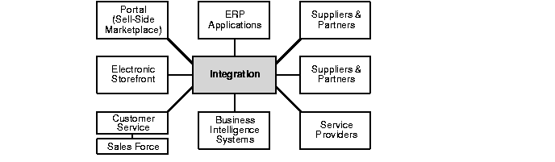
Introduction to E-Business Integration
The Internet revolution has advanced to the stage at which every enterprise must become an e-business. This is an imperative and not a choice. Hence, it is necessary to determine when and how an enterprise becomes an e-business.
What is e-business? It is a fundamental change to the way an organization conducts business. An e-business uses Internet technology to:
Attract, satisfy, and retain the customers who buy its products and services
Streamline supply chain, manufacturing, and procurement systems to efficiently deliver the right products and services to the customers
Automate corporate business processes to reduce cost and improve efficiency through self-service
Capture, analyze, and share business intelligence about customers and company operations. This enables management to make better business decisions and to continually refine business strategy.
An e-business requires a variety of Internet-enabled applications including e-commerce Web sites, portals, supply-chain management, procurement management, online marketplaces, customer relationship management, and enterprise resource planning. All these applications must be integrated with one another to make an enterprise an e-business.

Slide 10
Manufacturing
Manufacturing is the production of goods through the use of labour, machinery, tools and biological or chemical processing or formulation. Manufacturing can either mean transforming raw materials into finished goods on a large scale, or the creation of more complex items by selling basic goods to manufacturers for the production of items such as automobiles, aircraft, or household appliances.
Raw materials are transformed into finished products through manufacturing engineering or the manufacturing process. This process begins with product design and materials selection. The materials are modified during various manufacturing processes to create the finished product.
Modern advanced manufacturing often includes several intermediate processes to create the various components for a finished item, with some manufacturers using the term fabrication. Manufacturing has close connections to the engineering and industrial process design sectors.

Slide 11
What are the Types of Manufacturing?
1. Make-To-Stock (MTS):-In this system a factory produces goods that are held in stock at stores and showrooms. This means that a market for the goods needs to be predicted so that the items can be produced in advance ready for the consumer. However, producing too much can mean that surplus stock needs to be sold at a loss while producing too little may mean the market is missed and costs aren’t covered by sales.
2. Make-To-Order (MTO):-The make to order method allows the manufacturer to wait until orders are received before production begins. This makes it much easier to manage inventories and react to market demand. However, customers will need to wait for their products to be produced and the manufacturer will need a steady stream of orders to keep the factory in production and profitable.
3. Make-To-Assemble (MTA):-This method is similar to make to stock, except the factory will produce component parts in anticipation of orders for assembly. This means that the manufacturer is ready to fulfil customer orders as they arrive, but can leave the manufacturer with a stock of unwanted parts if there is no demand.

Slide 12
Why it is Important
Manufacturing is not only important in producing and delivering goods to the marketplace, but it is also important for economic reasons. In the United States, for example, manufacturing makes up 15% of the economic output. The mass production of items can provide a real boost to an economy, which can be measured by ‘manufacturing value added (MVA)’ indicators. These compare the manufacturing output to the size of the overall economy to create a percentage of gross domestic product (GDP). The figures for manufacturing employment, inventories and orders are examined by manufacturing institutes, such as The Institute for Supply Management (ISM), whose reports inform financial analysts and researchers.

Slide 13
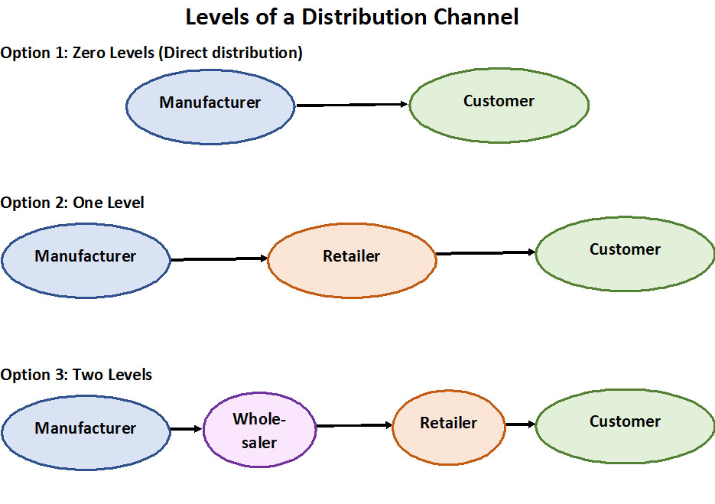

Slide 14
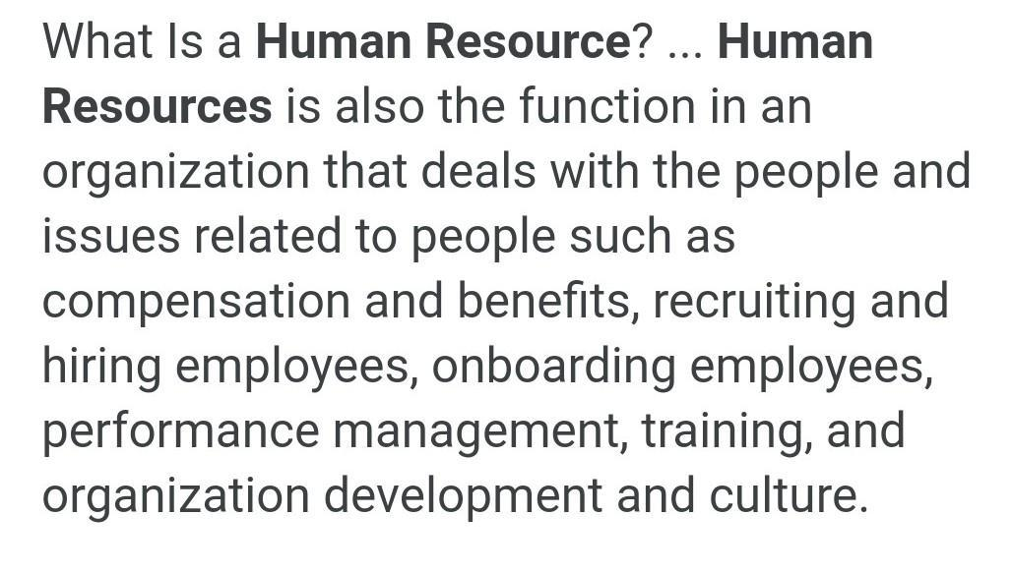

Slide 15
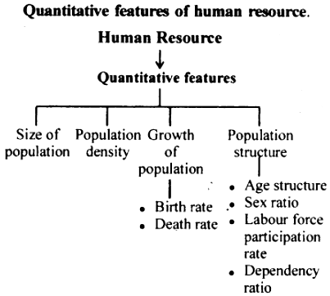

Slide 16
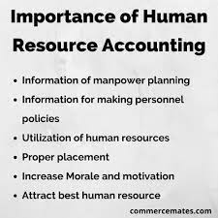

Slide 17
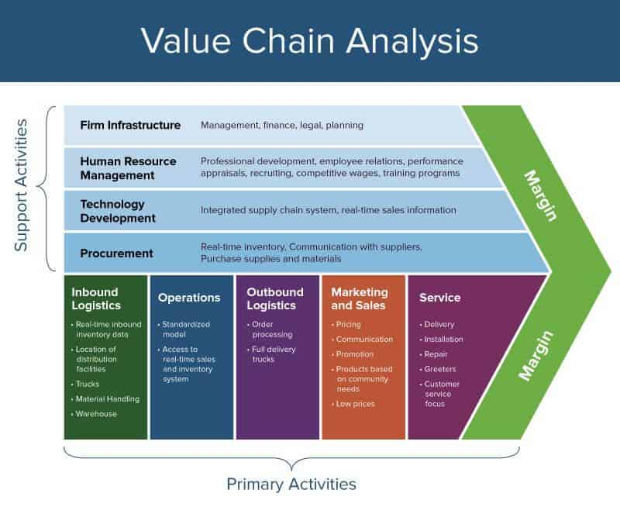

Slide 18
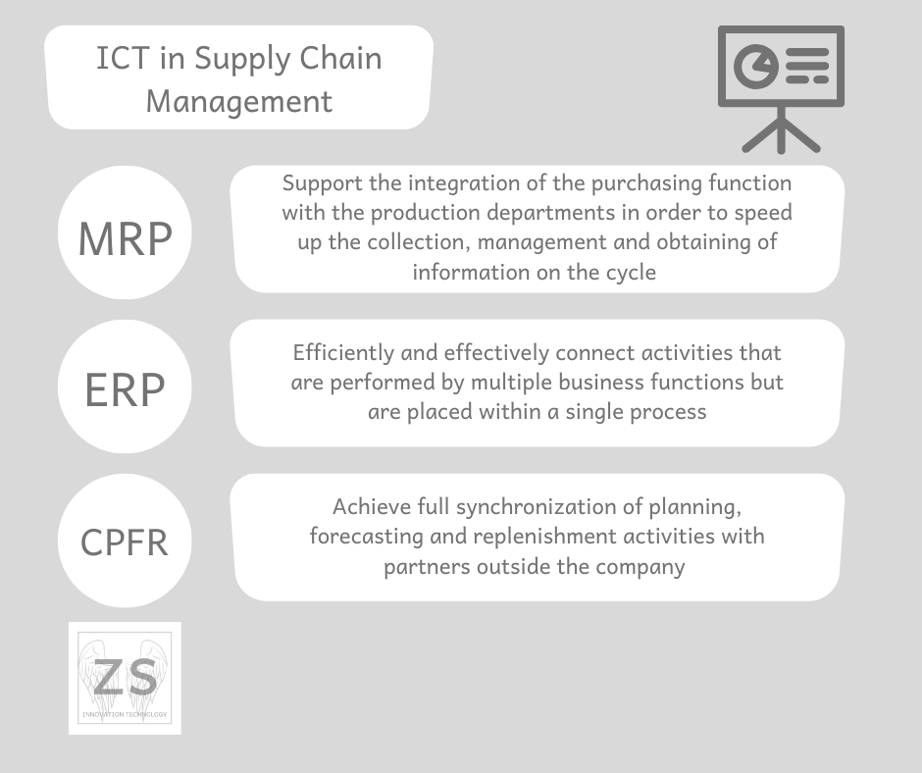

Slide 19
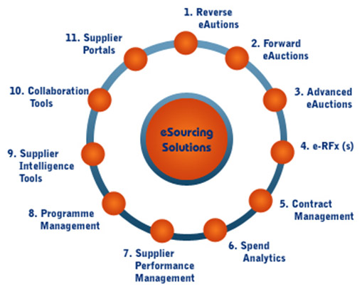

Slide 20
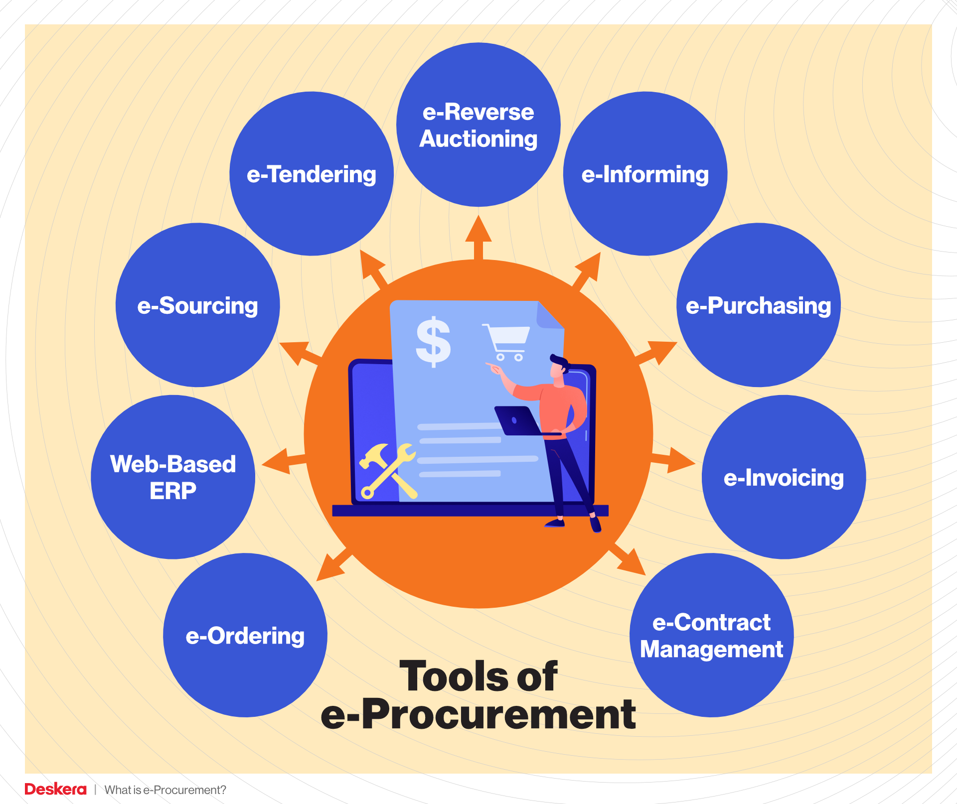

Slide 21
